Slide 1
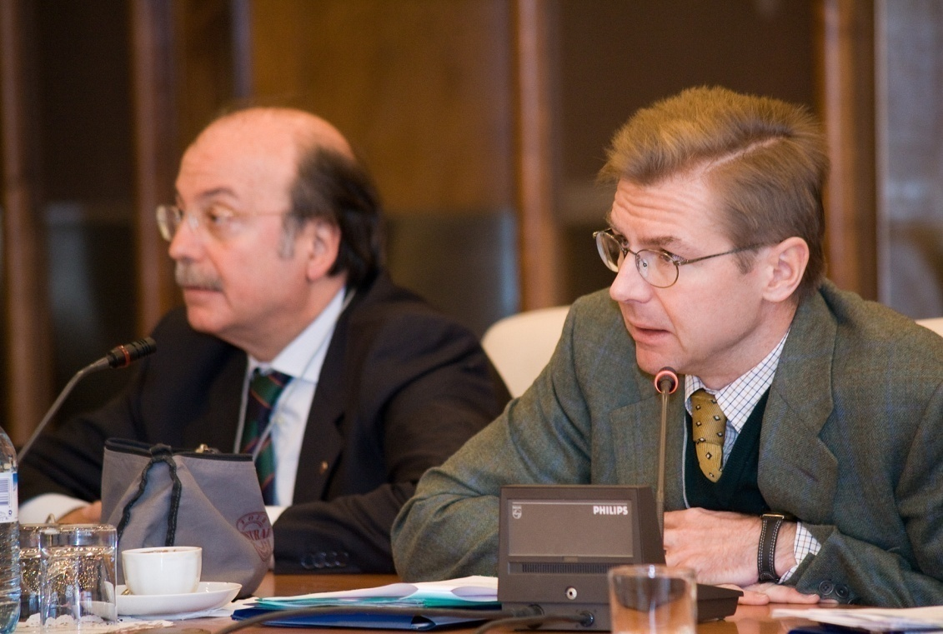
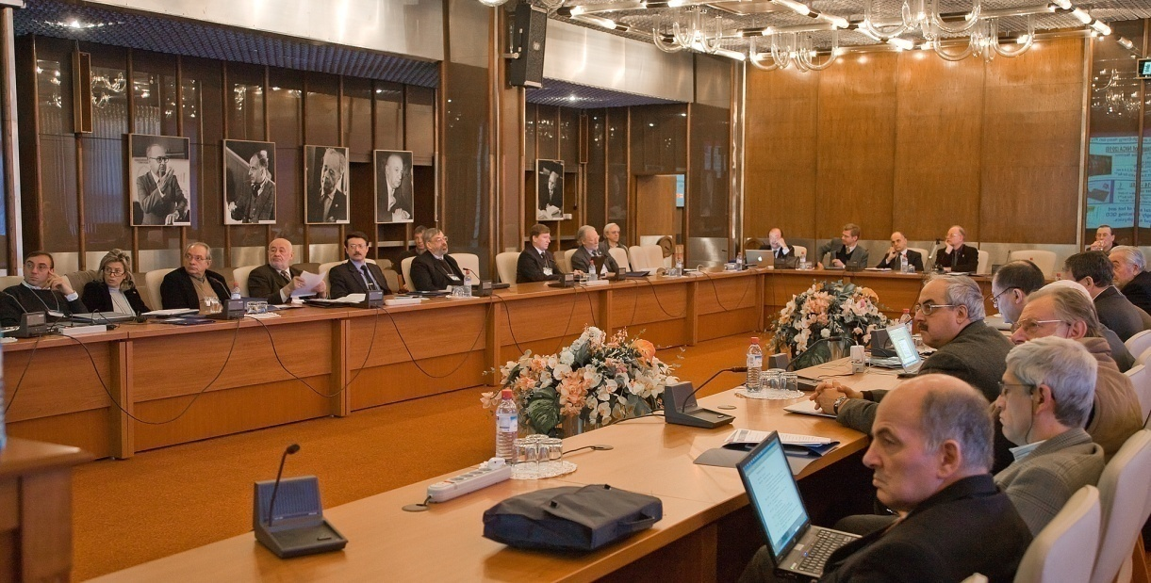


EU-Russia@Dubna Round Tables
A series of events with the goal of
promoting new scientific collabortions.
True scientific collaborations can have birth
only through the personal contact of scientists
who have a common interest, complementary
expertises aand first of all develop a
positive human relation among themselves
A new tradition founded December 2009

Slide 2
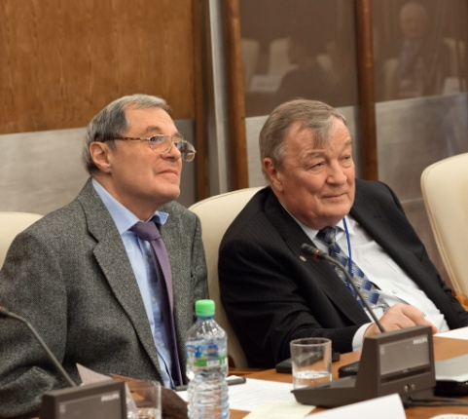



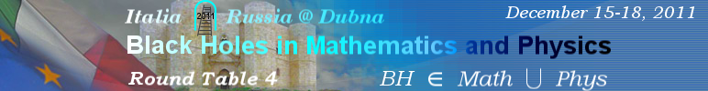

Five Previous Events
In Astrobiology
a very new field of investigations was created with very interesting results.
Physics, Mathematics, Astronomy and Biology
were discussed

Slide 3
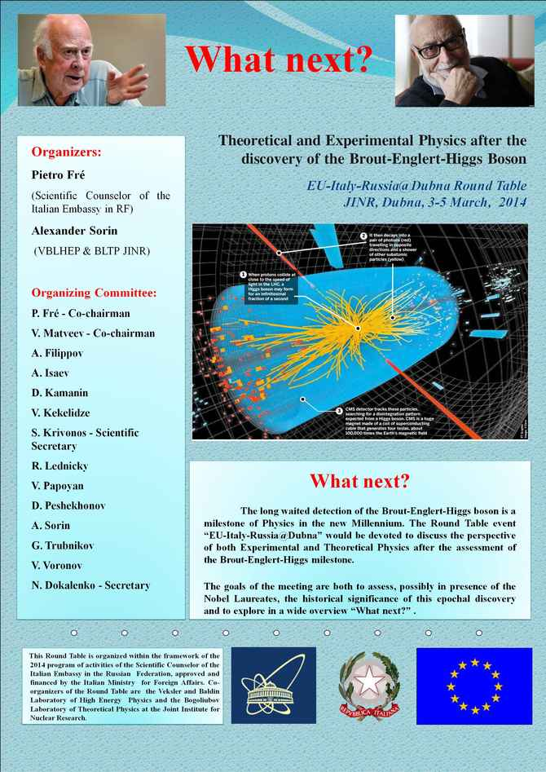
The Round Table WHAT NEXT
The long waited detection of the Brout-Englert-Higgs boson is a milestone of Physics in the new Millennium. To this experimental discovery, which completes the theoretical fabrics of the Standard Model contributed a lot of physicists and engineers from all over the world working at CERN. The Russian and JINR contribution to CERN activities and successes is very large and crucial. The Italian contributions to CERN successes is also very important and conspicuous. The goals of the meeting are both to assess, the historical significance of this epochal discovery and to explore in a wide overview “What next” .

Slide 4
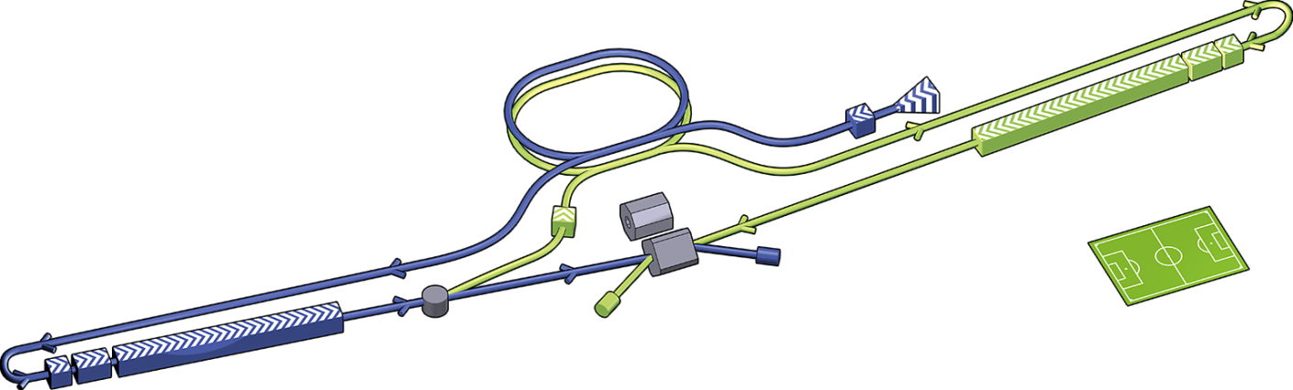
To have a “NEXT” some conditions have to be satisfied:
The International Linear Collider
We need new larger accelerators
This requires large international collaborations. EU and Russia have certainly to be part of them.
We need strong interdisciplinary, international collaborations, theoretical and experimental
Here the best frameworks are Networks hence...
We probably need Large Networks of new conception
EU – Russia Networks are a great challenge
In the past we had the Networks.....

Slide 5
In previous Frame Plans we had the Networks
The Networks played a very important role
They helped forming coherent and well functioning scientific communities
They provided jobs for young scientists
They allowed extensive continental circulation of postdocs
They allowed to share best practices in the selection and evaluation of young scientists
They provided the means of organizing Large Conferences and Thematic Graduate Schools

Slide 6
Some Theoretical Networks in Previous EU - Frame Plans
SCIENCE Programme (1992-1996)
TMR Programme (1996 -2000)
RTN Programme (2000 – 2004)
Marie Curie Action Programme (2004 -2008)
Within the framework of these Programmes there were up to three parallel NetWork
Groups in String Theory, Supergravity and allied Theoretical Physics Topics.
The Organization of these Networks played a very important
role at the continental level giving birth to a coherent Community of Scientists,
introducing Sequential Conferences, exchange of Post Doctoral Fellows,
Specialized Winter Schools and significantly improving the
capability of Planning Together Future Steps and Collaborations.
Two of the Scientists who acted as Central Coordinators of such Networks are today present
in this Conference Room
PROF. ANTOINE VAN PROEYEN of Katholieke Universitat Leuven (Belgium)
PROF. IGNATIOS ANTONIADIS of Ecole Politechnique (France) and CERN

Slide 7
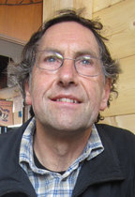
TMR project ERBFMRXCT96-0045 Quantum aspects of gauge theories, supersymmetry and unification 1996 – 2000
Belgium: K.U. Leuven, V.U. Brussel
The Netherlands: Utrecht, Groningen
France: Paris ENS
Switzerland: Neuchâtel
United Kingdom: London Imperial College
Denmark: Copenhagen Nordita
Germany: H.U. Berlin, München Ludwig Maximilians, Bonn
Italy: Torino univ, Torino politecnico, Genova, Milano
Italy: Frascati, Padova, Napoli, SISSA Trieste
Central Coordinator
Antoine Van Proeyen

Slide 8


The quantum structure of spacetime and the geometric nature of fundamental interactions
2000 - 2004
Belgium: K.U. Leuven, V.U. Brussel , U.L.Bruxelles
The Netherlands: Utrecht, Groningen
France: Paris ENS
United Kingdom: London Imperial College
Spain: Barcelona (ass. to London)
Denmark: Copenhagen Nordita
Germany: H.U. Berlin,
Germany: Bonn, Potsdam
Switzerland: Neuchâtel
Italy: Torino univ, Torino Politecnico , Milano 1
Italy: Padova, SISSA Trieste , Milano 2
Italy: Frascati, Genova, Napoli
Greece: Heraklion
Central Coordinator
Antoine Van Proeyen

Slide 9
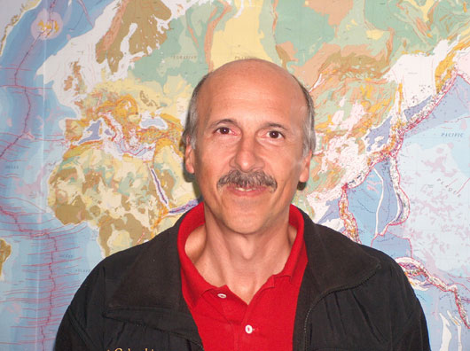
Physics Across the Present Energy Frontier:
Probing the Origin of Mass
2000 - 2004
Centre de PHysique Théorique, Ecole Polytechnique, FRANCE
Service de Physique Théorique, Centre d'Etudes de Saclay, FRANCE
Physikaliches Institut, Universität Bonn, GERMANY
Physics Division, School of Technology, Aristotle University of Thessaloniki, GREECE
Istituto Nazionale di Fisica Nucleare, Padua, Pisa, Rome-1 and Rome-2, ITALY
Scuola Internazionale Superiore di Studi Avanzati, Trieste, ITALY
Centro de Física das Interacções Fundamentais, Departamento de Física, Lisbon, PORTUGAL
Instituto de Física Teórica, Universidad Autónoma de Madrid, SPAIN
Astroparticle and High Energy Group, Instituto de Fisica Corpuscular, Universitat de Valencia, SPAIN
Department of Physics, Theoretical Physics, University of Oxford, UNITED KINGDOM
Uniwersytet Warszawski, POLAND
Theory Division , CERN, SWITZERLAND
Central Coordinator
Ignatios Antoniadis

Slide 10

The Theoretical Network in the 6th Frame Plan

Slide 11
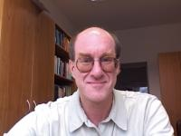
Ludwig-Maximilians-Universität München
Max-Planck-Institut für Gravitationsphysik Potsdam
Universidad de Barcelona, Universidad de Valencia
Consejo Superior de Investigaciones Cientificas Madrid, Universidad de Santiago de Compostela , Universidad de Oviedo
Institudes des Hautes Etudes Bures-sur-Yvette, Ecole Polytechnique
Ecole Normale Superieure Paris (CRNS), Service de Physique Theorique Saclay
Nordita Copenhagen
Trinity College Dublin
INFN Frascati, INFN - Sezione di Napoli
Torino University, Torino Politecnico , University of Alessandria
K.U. Leuven
Imperial College London
Universite de Neuchâtel
University of Patras
Institute for Nuclear Research and Nuclear Energy of the Bulgarian Academy of Sciences Sofia
Universiteit Utrecht
Universität Bonn
University of Iceland
Padova University, SISSA Trieste
Universita de Milano-Bicocca, Universita di Milano (Milano I)
V.U. Brussel, U.L.Bruxelles
University Edinburgh
ETH-Zürich
University of Craiova
Groningen University
Dieter Luest Central Coordinator
Constituents, Fundamental Forces and Symmetries of the Universe
November 2004 – November 2008

Slide 12
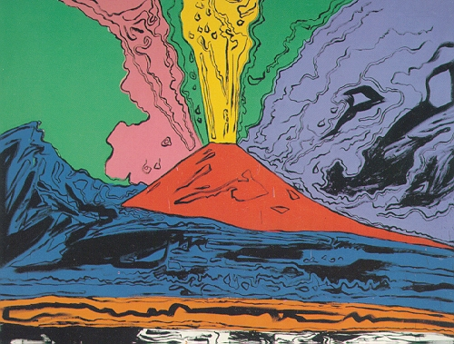
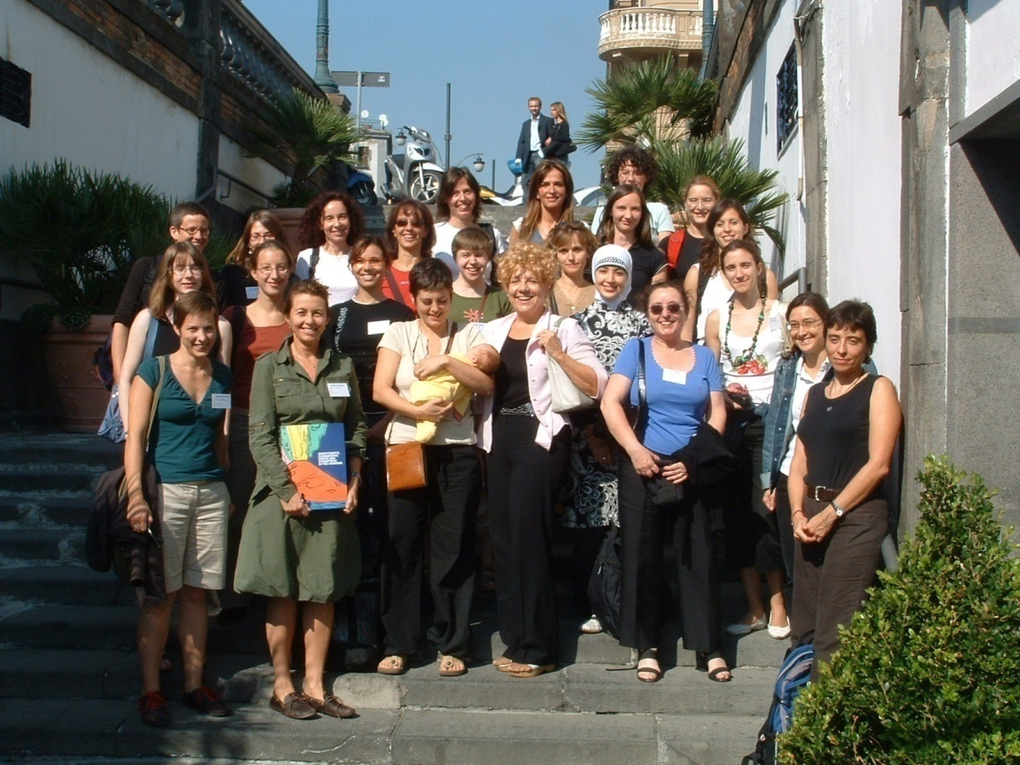
Women participants of the MidTerm Meeting in Naples 2006
Each One of the Four Years there was a Big
Network Conference
The Participants to the MidTerm Meeting in Naples were 204 / There were about 50 thirty minute talks

Slide 13

January 31 - February 4 2005 SISSA, Trieste, Italy
This School takes place yearly in the framework of the EC-RTN network "Constituents,Fundamental Forces and Symmetries of the Universe". Its aim is to try to give a pedagogical introduction to selected topics in string theory and related matters.
Lecture Notes on D-brane Models with Fluxes R. Blumenhagen
Topological String Theory on Calabi-Yau threefolds A. Klemm
Introduction to Cosmology V.A. Rubakov
Lectures on Twistor String Theory and Perturbative Yang-Mills Theory F. Cachazo and P. Svrcek
RTN lectures on the non AdS/non CFT Correspondence A. Zaffaroni
Winter Schools
Every Year, the Various Networks organized WINTER SCHOOLS
For Graduate Students and Young Post Docs

Slide 14
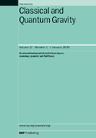

The TMR Winter School in Torino, year 2000, had about 200 participants
Contemporary string theory
and brane physics.
Proceedings, 2nd Graduate School, Turin, Italy, January 26-February 2, 2000
M. Billo (ed.) , M. Frau (ed.) , P. Fre (ed.) , A. Lerda (ed.) , I. Pesando (ed.) , S. Sciuto (ed.) (Turin U.)
Conference: C00-01-26 (Class.Quant.Grav.17:3377-3597,2000)
Contributions

Slide 15
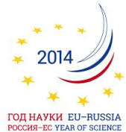
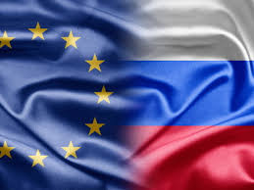
Ideas about EU – Russia MegaNetworks
All participants to RT have received a short document entitled
Topics for.....
It contains the description of some
Pilot Network SEEDS

Slide 16
THREE PRELIMINARY PROPOSALS
Pilot NetWork seed One
Cosmology and Particle Physics after the Discovery of the BEH boson
Pilot NetWork seed Two
Molecular Biology, Medicine, Radiation and Space
Pilot Network seed Three
Heavy Ion Physics and the Development of magnet Technologies, Electronic Technologies and Information Technologies

Slide 17
More details you find in the distributed document
We hope that around these ideas some concrete steps can be taken toward the construction of some
EU-Russia MegaNetwork already in the next days during the Round Table. Indeed we have here a challenging opportunity to talk and exchange ideas and suggestions...
THANK YOU FOR YOUR ATTENTION

